Slide 1
LOS ANGELES CRIME ANALYSIS
DATS 6103 – Individual project 2
Darshan Kasat

Slide 2
objective
to analyze the crime data of los angeles and gain remarkable insights from the data.

Slide 3
About the dataset
Data downloaded from :
https://data.lacity.org/a-safe-city/crime-data-from-2010-to-present/y8tr-7khq
Data from year 2010 to 2017
Consists of 1.62 million records approximately and 26 columns.
Last updated on December 05, 2017

Slide 4


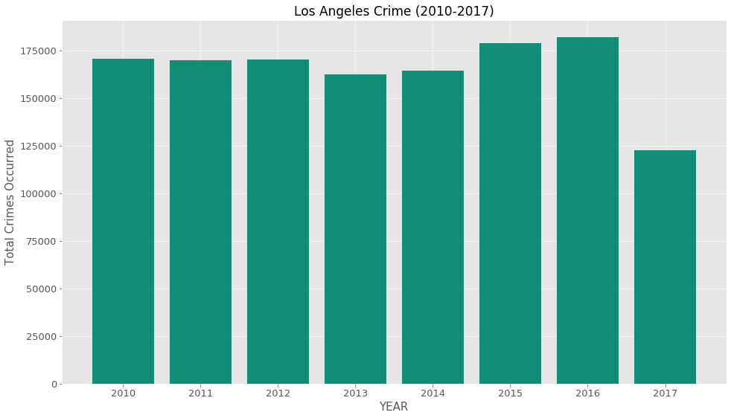
Year wise crime in la
Crime rate dropped a little in year 2013 and 2014, but it increased in 2015 again
Crime rate was highest in year 2016
Crime rate dropped significantly in year 2017.

Slide 5
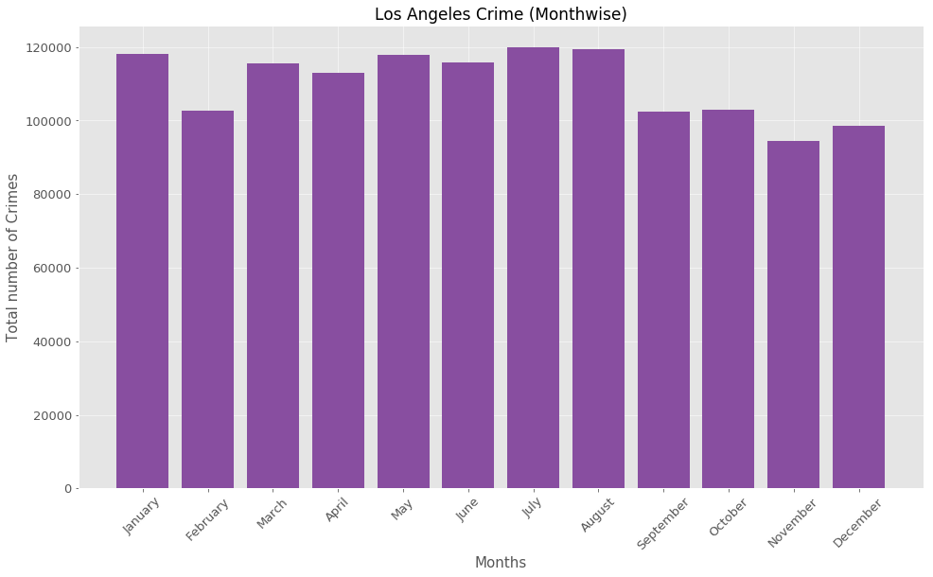
Month wise crime rate in LA
Crime rate is high in the month of June, July, August
Crime rate from September to December is relatively lower.

Slide 6
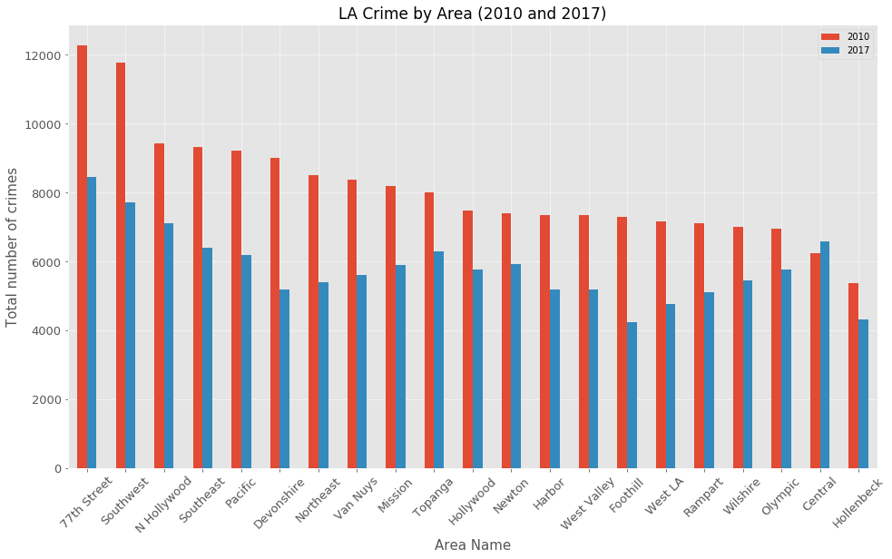
Area wise crime rate in la
77th street and Southwest areas in LA had the most number of crimes from year 2010 to 2017.
Crime rate dropped significantly in areas such as Devonshire and Foothill.

Slide 7
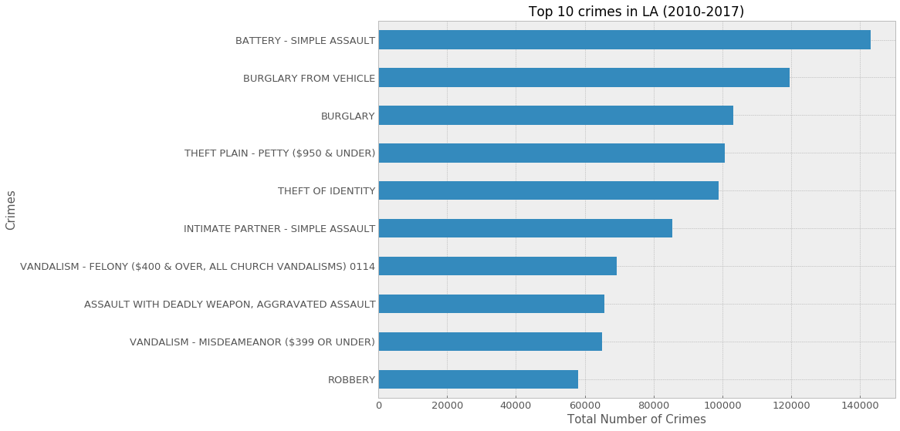
Top 10 crimes in la
These are the top 10 crimes in LA from year 2010 to 2017

Slide 8
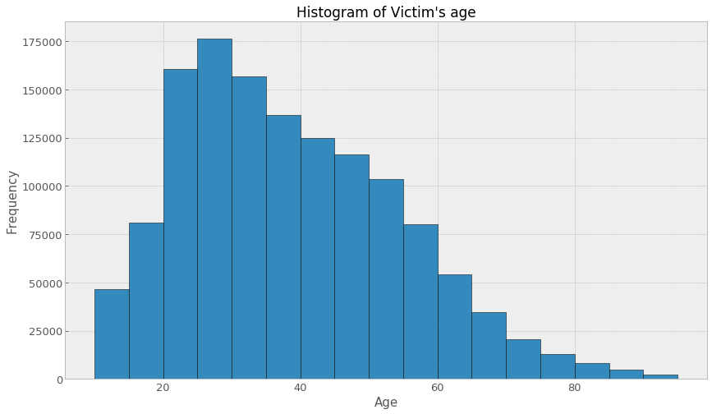
Is there any particular age group targeted by criminals?
People in the age group of 20-40 years seems to be the victims of crimes.

Slide 9
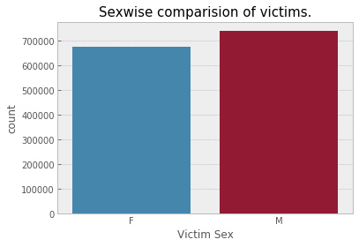
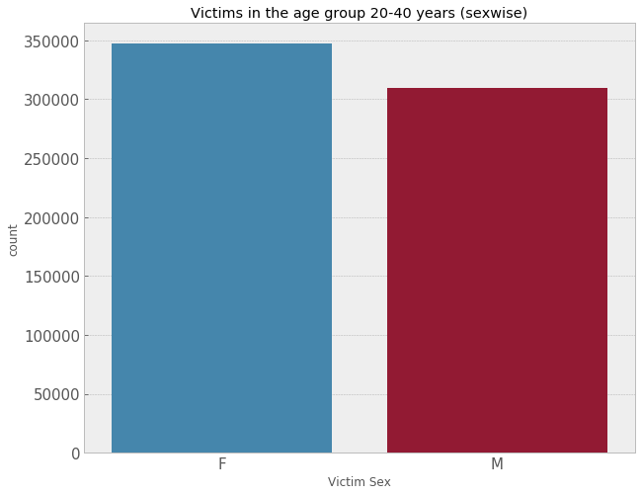
Gender of victims
In general more number of males are the victims of a crime.
But, females in the age group of 20-40 years are targeted by criminals

Slide 10
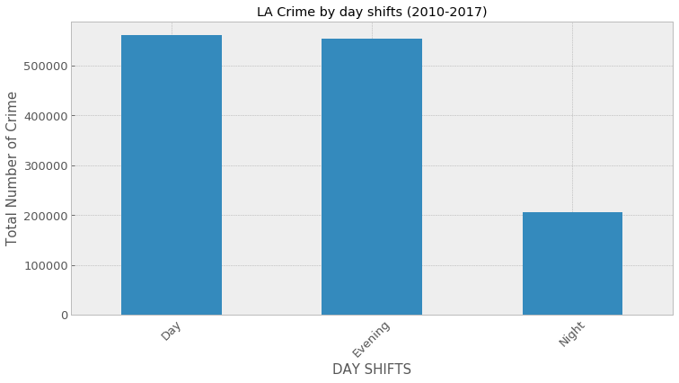
Shiftwise analysis of crime
Crime rate is higher in day and evening as compared to night

Slide 11
conclusions
Crime rate in LA was very high in years 2015 and 2016. But, it dropped significantly in year 2017.
Crime rate from September to December is low compared to rest of the months except February.
77th street and Southwest regions in LA are the most unsafe areas. Whereas, Devonshire and Foothill are the safest areas in Los Angeles.
Simple assault, burglary from vehicle and burglary are the most frequent crimes in Los Angeles.
People in the age group of 20-40 years are most likely to be the victims of a crime.
There were more male victims than female. But, females in the age group of 20-40 years are targeted more by the criminals.
Crime rate is pretty high from 7 am to 11 pm. But it plummets after 11 pm.

Slide 12
Thank you

